Slide 1
Image Classification (Animal)
using CNN Deep Learning Technique
Presented By:
Name : DhineshKumar S
Reg No : 730321104010
College Name : Builders Engineering College
3/21/2024
Annual Review
1

Slide 2
PROJECT TITLE
Image Classification (Animal)
using CNN Deep Learning Technique
3/21/2024
Annual Review
2

Slide 3

1. Problem Statement.
2. Project Overview.
3. Who are the end users.
4. Special features.
5. Modelling.
6. Results
7. Conclusion.
AGENDA
3/21/2024
Annual Review
3

Slide 4

PROBLEM STATEMENT
Traditional image classification methods face challenges in accurately distinguishing between similar-looking animal species, dealing with variations in pose, lighting conditions, and background clutter, necessitating the development of advanced techniques.
Key Challenges:
1. Fine-grained classification
2. Data variability and diversity
3. Data imbalance
4. Limited availability of labeled data
5. Generalization to unseen environments
3/21/2024
Annual Review
4

Slide 5

PROJECT OVERVIEW
Our image classification system project aims to develop a robust and efficient solution for categorizing images into predefined classes using Deep learning techniques like CNN algorithm. With the proliferation of digital images across various digital animals images, the need for accurate and automated image classification systems has become increasingly essential.
3/21/2024
Annual Review
5

Slide 6

WHO ARE THE END USERS?
1. Agricultural Experts and Farmers
2. Healthcare experts
3. Autonomous Vehicles
4. Environmental Scientists
5. Wildlife Researchers
3/21/2024
Annual Review
6

Slide 7

SPECIAL FEATURES :
1. Visual Representation Learning
2. Spatial Hierarchies and Context
3. Class Imbalance Handling
4. Adaptability to Real-World Applications
5. Scalability and Efficiency
3/21/2024
Annual Review
8

Slide 8
MODELLING
Problem Definition: Clearly define the problem you want to solve with image classification. Determine the classes or categories you want to classify images into.
Data Collection: Gather a dataset of images that represent the classes you want to classify. Ensure that the dataset is diverse, balanced, and of sufficient size to train a robust classifier.
Data Preprocessing: Preprocess the images to prepare them for the training process. Common preprocessing steps include resizing images to a consistent size, normalizing pixel values, and possibly augmenting the data with techniques like rotation, flipping, and cropping to increase variability.
3/21/2024
Annual Review
9

Slide 9
Model Evaluation: Evaluate the trained model's performance on the test set to assess its accuracy, precision, recall, and other relevant metrics. This step helps determine how well the model generalizes to unseen data.
Model Deployment: If the model performs satisfactorily, deploy it to make predictions on new, unseen images. This may involve integrating the model into an application or system where it can classify images in real-time.
Monitoring and Maintenance: Continuously monitor the model's performance and retrain it periodically with new data to ensure that it remains accurate and up-to-date.
3/21/2024
Annual Review
9

Slide 10
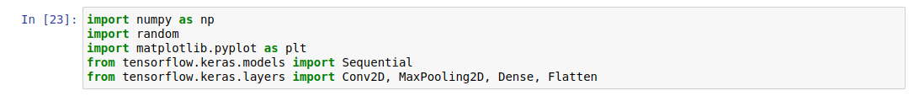
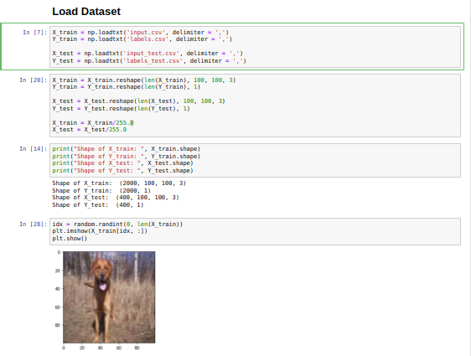
RESULTS

Slide 11
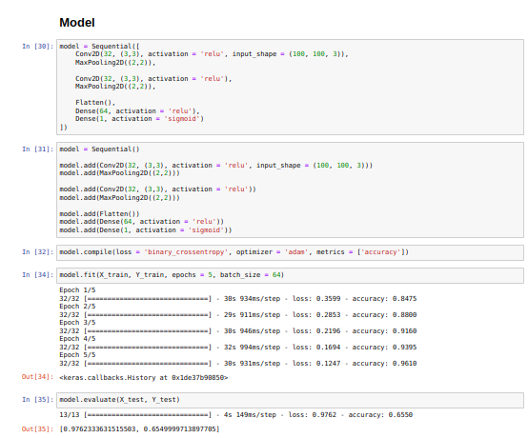
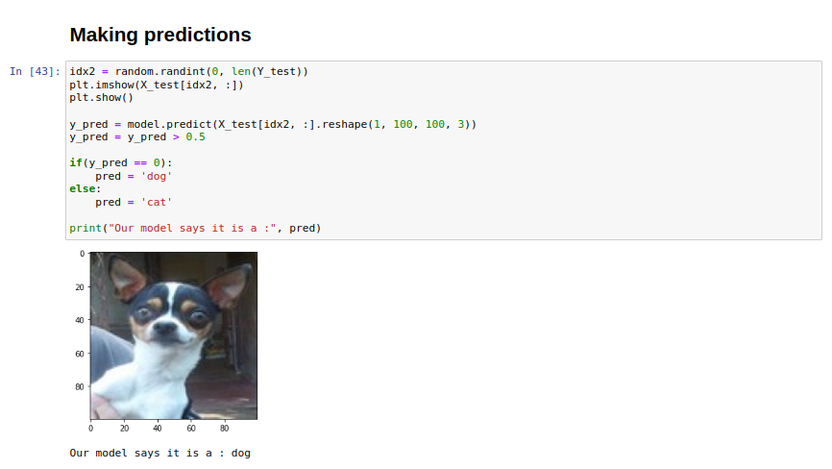
Demo link :

Slide 12
Conclusion
In conclusion, our image classification project has successfully achieved its objectives of accurately categorizing images into predefined classes using Deeplearning techniques. Through the utilization of state-of-the-art convolutional neural networks (CNNs) such as ResNet, Inception, or VGG, we have demonstrated the capability to classify diverse images with high accuracy.
3/21/2024
3/21/2024
Annual Review
Annual Review
8
6

Slide 13
Thank You
3/21/2024
3/21/2024
Annual Review
Annual Review
8
6

